Slide 1
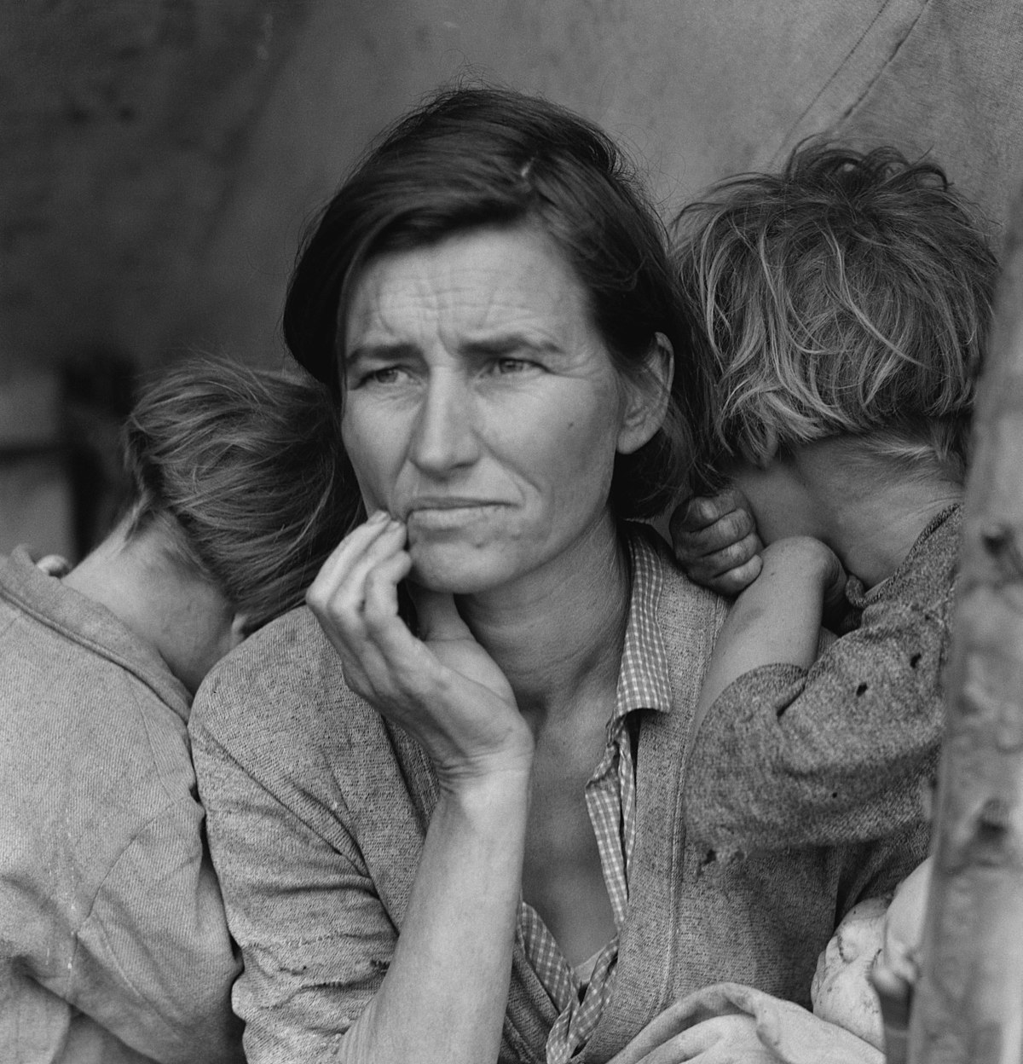
The Great Depression and the New Deal
The impact of the stock market dealings throughout the 1920s
How these led to the Wall Street Crash of 1929
Other factors which contributed to the Great Depression
The spiral into economic depression
The short-term and long-term social, political and economic impacts, including the impact on capitalism and on different groups in society
Political responses, including:
Hoover and ‘Rugged Individualism’
Roosevelt and the ‘New Deal’

Slide 2
The story so far…
1865-1900
1900-1918
1918-1920
1920-1929

Slide 3
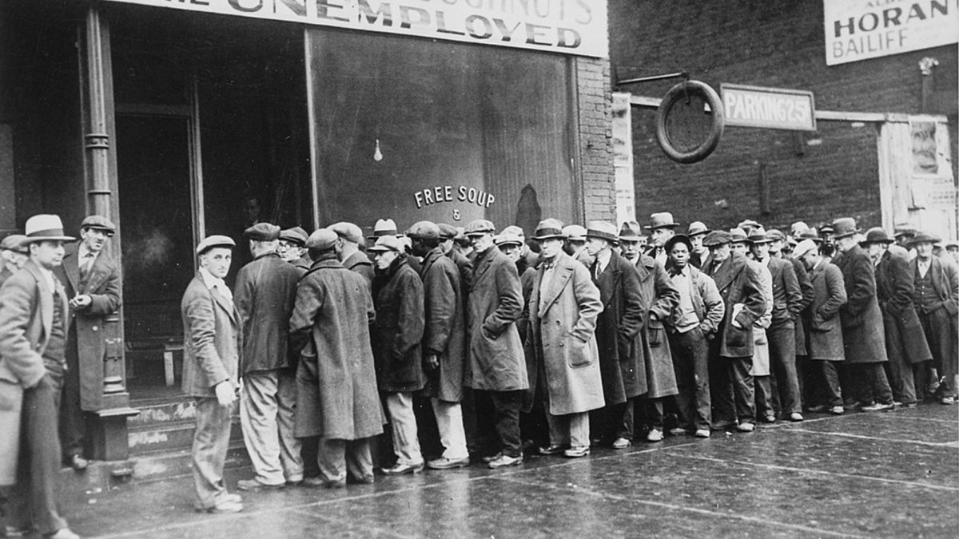
The Great Depression Explained in One Minute
https://www.youtube.com/watch?v=Sv7IP2qL0gg

Slide 4
Leading up to the Wall Street Crash
Economic boom of 1920s based upon business confidence – economic growth continue indefinitely
Readily available credit finance
Serious imbalances, inequities and contradictions in US economy
Many American companies produced more than people could afford to buy (overproduction)
Average income began to decline from 1927
By 1929, 35% of the personal income went to 5% of people

Slide 5
The Wall Street Crash – A Catalyst
24 Oct 1929 – 29 Oct 1929
Wall Street Stock Exchange rose at astonishing rate between 1927-1929
Many shares bought ‘on the margin’, or with credit (borrowed money).
Market peaked September 1929.
Late September a decline in confidence occurred among investors.
In October this resulted in:
October 21 prices began to fall sharply
October 24 ‘Black Thursday’ the Wall Street Crash began – 12.5 million shares sold
The Wall Street Crash was not the cause of the Great Depression, it was the catalyst of ‘trigger’ which highlighted deep-seated problems within the US economy.

Slide 6
The Great Depression - CAUSES
‘Staple’ industries depressed
Agricultural sector depressed
Overproduction of new and old industries
Undercapitalisation of banks
Grossly unequal distribution of wealth
Much of speculation of 1920s financed by credit

Slide 7
The Great Depression – underlying causes deepened the Depression
Few would invest in stocks – business investment suffered
People withdrew money from banks – smaller banks collapsed bringing greater hardship to other depositors
Businesses began to lay off workers and pay the remaining workers less
People stopped buying goods as they were being payed less or not at all
Businesses were not selling goods as people were not buying, so had to lay off more people

Slide 8
The extent of the Great Depression
The ‘Great Depression’ was larger and longer, and created more suffering and economic, social and political dislocation, than any other economic recession before or since.
The economy of the USA saw:
GNP fall from $106 billion in 1929 to $57 billion in 1933
Between 1929 and 1933 around 10,000 banks failed and collapsed
Unemployment rose from 1.5 million in 1929 to 12.5 million in 1933 (one in four)
Agricultural, forestry an fishery income dropped from $8.5 billion in 1929 to $3.3 billion in 1933

Slide 9
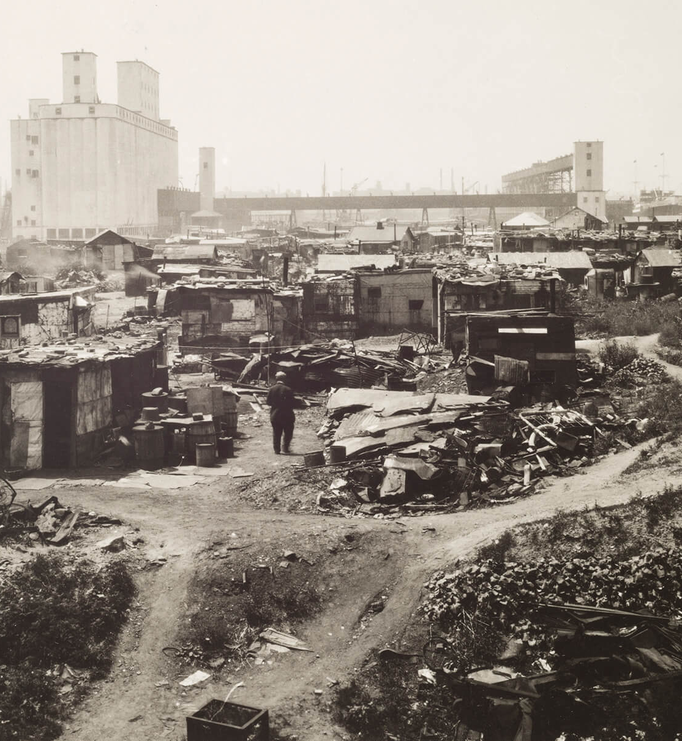
The extent of the Great Depression – SOCIAL https://www.youtube.com/watch?v=gkAfjRolNCI&t=59s
Divorce rate rose
Bread and soup lines became a common sight
Homelessness rose – ‘Hoovervilles’

Slide 10
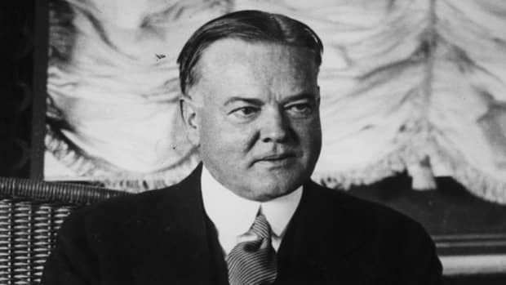
Hoover’s reaction to the GD
Attempted to restore confidence
“All the evidences indicate that the worst effects of the crash upon unemployment will have been passed in the next 60 days.”
Rugged individualism: The belief that all individuals can succeed on their own and that government help for people should be minimal.

Slide 11
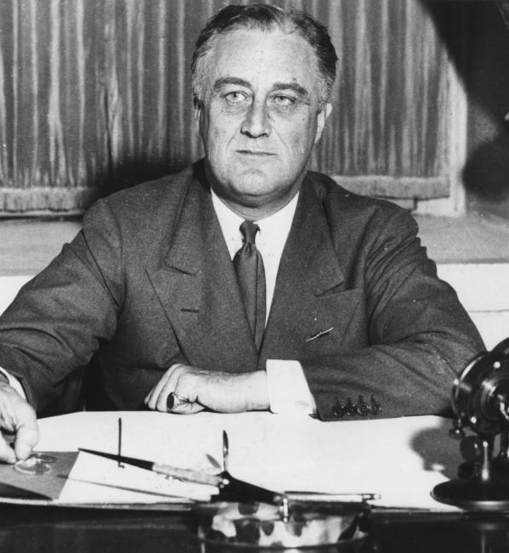
Franklin D. Roosevelt
Won Presidential election 1932 by landslide
Compared to Hoover, Roosevelt was seen as being proactive about Depression
Introduced ‘Fireside Chats’
Introduced the ‘New Deals’

Slide 12

First New Deal 1933-1935
In ‘The First 100 Days’ (Congress emergency session) after FDR’s inauguration a range of agencies (Alphabet Agencies’ were established to implement the Three R’s.
‘Relief, Recovery, Reform’ (Three R’s)
Relief: to bring immediate help to those in need
Recovery: provide jobs for people
Reform: to institute changes in economic system in order to prevent another Depression

Slide 13
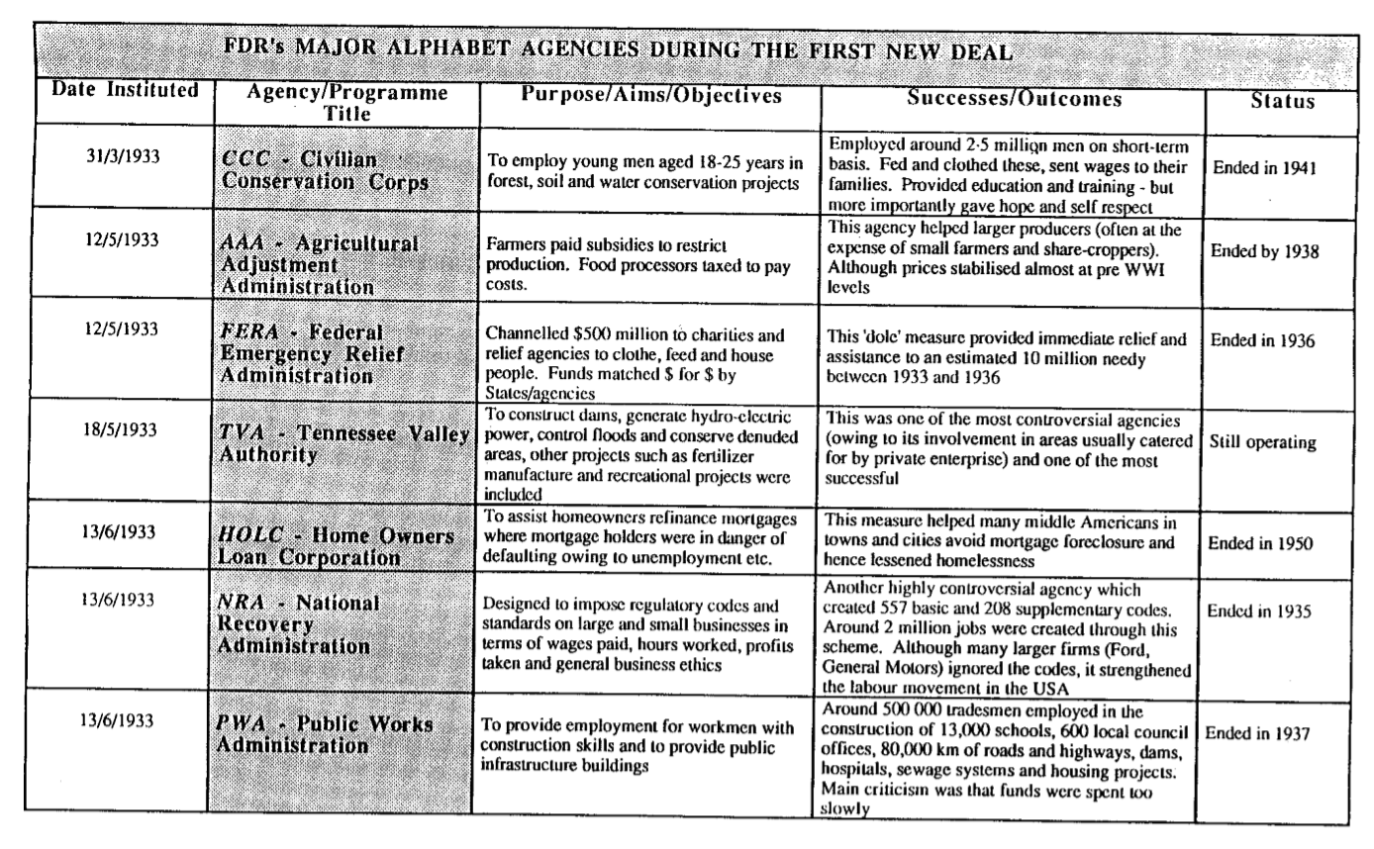

Slide 14

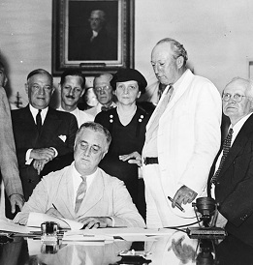
Second New Deal 1935-1939
‘Second 100 Days’ where bills passed swiftly
With First New Deal, FDR relieved worst cases of hardship
Became more concerned with recovery and reform

Slide 15
Opposition to the New Deal
The Supreme Court
From 1933 to 1936, FDR encountered legal obstacles to parts of his New Deal
The Right
Argued FDR’s measures went too far toward people relying on welfare
The Left
Argued FDR’s measures did not go far enough

Slide 16
An evaluation of the New Deal
Successes | Limitations | Significance
Restored confidences in economic and political systems in USA Heralded a new approach to managing government finances Millions of jobs created | Poverty (50% of population) and unemployment (8 million workers) still existed in both rural and urban USA A complete recovery not achieved until US entry to WW2 | Won over millions of voters to Democratic Party for next 20 years Seen as a revolutionary response to problems in US

Slide 17
Understanding the Great Depression
https://www.youtube.com/watch?v=m6JLCHwNdT4

Slide 18
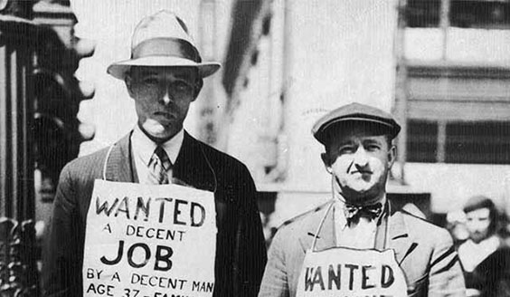
1929-1939 timeline
Find the following key events/ideas. Create a timeline using these events and ideas and provide a short explanation for what they were. (they are not in chronological order).
New deals
Wall street crash
End of Prohibition
Hoover becomes President
Alphabet agencies
FDR becomes President
America enters WW2
WW2 begins

